Slide 1
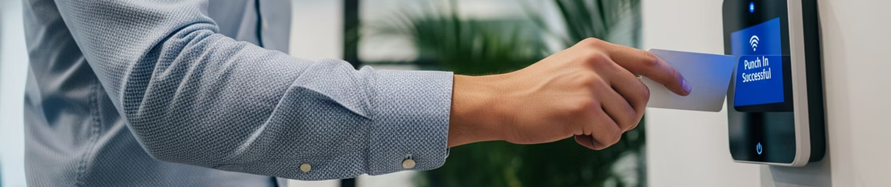
Automated Employee Attendance System Using RFID Technology

Slide 2
Submitted By:
Jollu Venkateshwara Reddy
Deekshith H S
Ritesh Kumar
V24BE8J4
V24BE8D8
V24BE8R5
ECE
ECE
IT
Aditya College of Engineering
Jawaharlal Nehru National College of Engineering
Rustamji Institute of Technology

Slide 3

Introduction
The RFID-based Attendance System is an automated method to record attendance using Radio Frequency Identification technology.
Automates attendance using RFID technology.
Integrates real-time clock for accurate timestamps.
Reduces manual errors and saves time.
Provides secure and efficient attendance management.

Slide 4
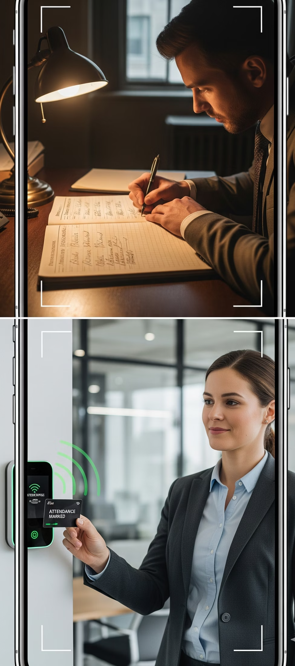
Problem Statement & Objective
Problem Statement:
Manual attendance is time-consuming.
High chances of errors and manipulation.
Objectives:
Automate attendance marking.
Real-time date & time stamping.
Log attendance data for further processing.

Slide 5
Literature Survey
“RFID-Based Attendance System Using ARM7 (LPC2129)” – by A. Deshmukh & N. Pawar (2020)
Utilized the LPC2129 microcontroller for processing RFID input from EM-18.
Improved speed and response time with UART-based serial communication.
Limitation: Lacked cloud integration for real-time remote access
RFID-based systems used in schools/offices.
Microcontroller-based automation projects.
Serial logging methods for data storage.
Gaps Addressed:
Accurate timestamps with RTC.
Integration with Linux-based logging.
Improved reliability using interrupts.

Slide 6
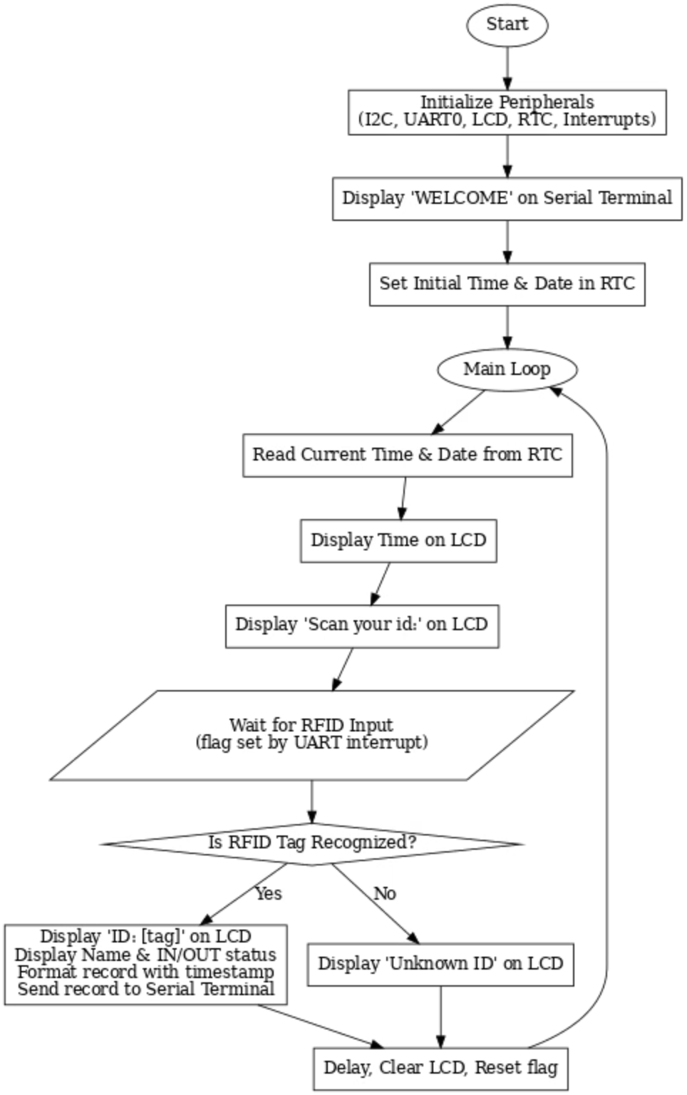
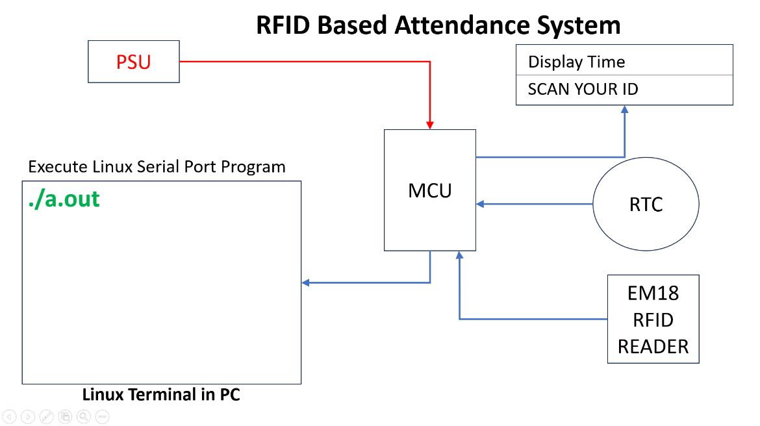
Proposed System
Block Diagram and Flowchart

Slide 7
Hardware/Software Used
Hardware:
LPC2138 Microcontroller
RFID Reader
DS1307 RTC
16x2 LCD
Push Buttons
Software:
Keil uVision (Embedded C)
Proteus (Simulation)
Linux (GCC, Serial Program)

Slide 8

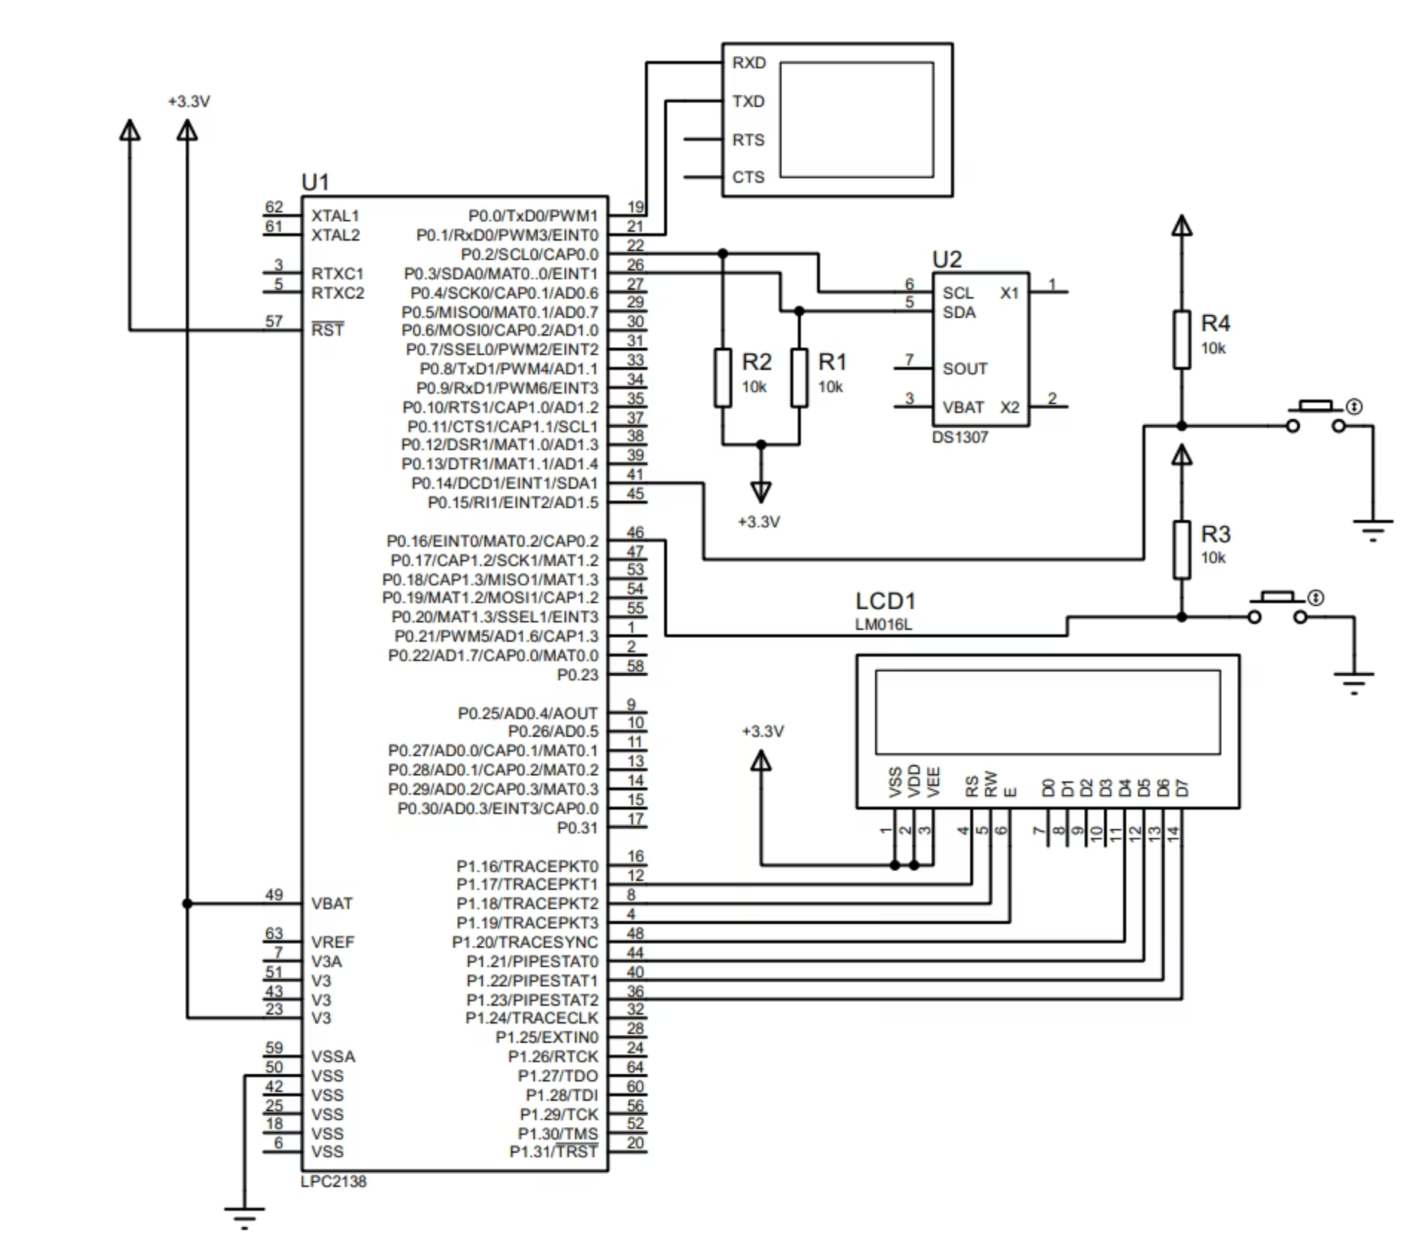
Implementation
Working Steps:
RFID tag scanned by reader.
LPC2129 fetches tag ID + time from RTC.
Info displayed on LCD.
Data sent to PC via UART.
Linux program logs attendance.

Slide 9
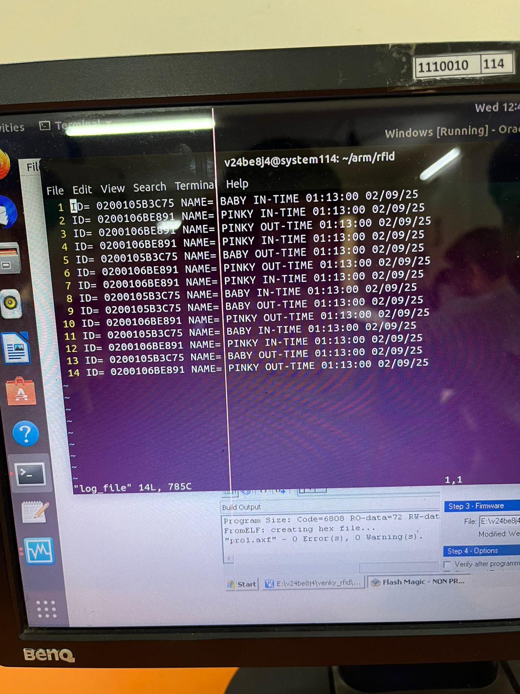
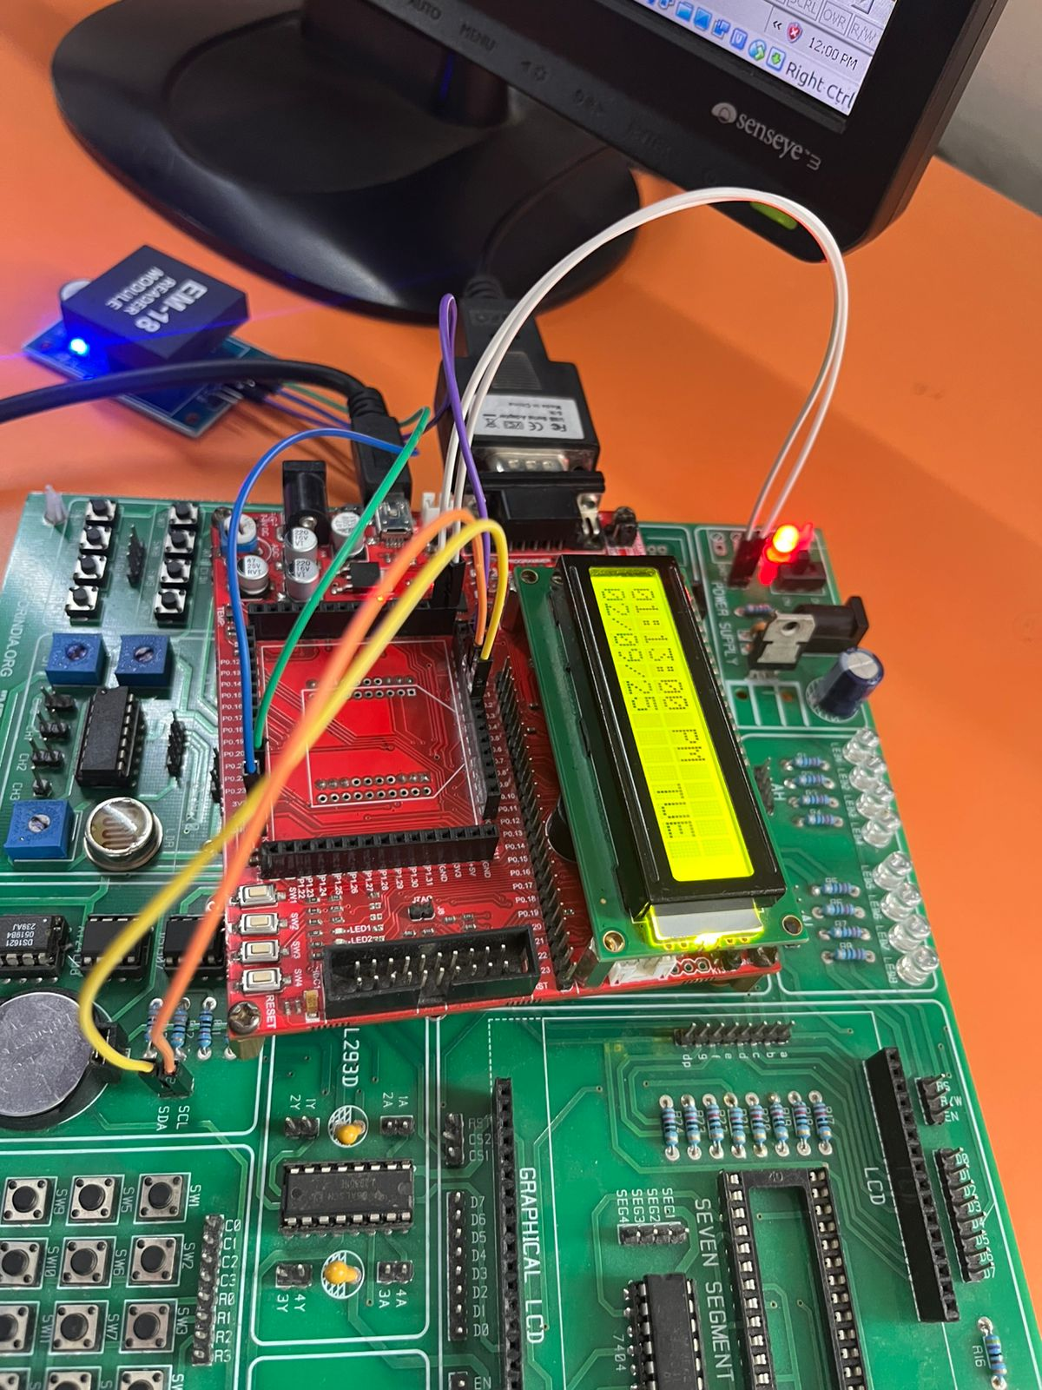
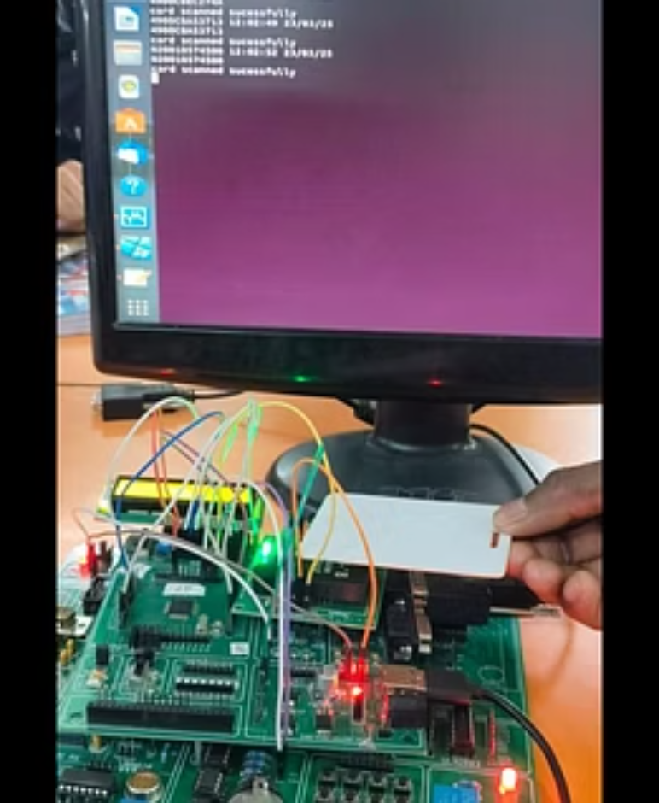
Results

Slide 10
Conclusion & Future Scope
Conclusion:
Accurate, automated attendance achieved.
Reliable logging with timestamps.
Future Scope:
Computer vision Integration.
Integration with database/web portal.
Use of biometric authentication.

Slide 11
REFERENCES
Deshmukh, A., & Pawar, N. (2020). RFID-Based Attendance System Using ARM7 (LPC2129). International Journal of Embedded Systems, 12(3), 45–50.
Mehra, P., Kumar, S., & Joshi, R. (2019). Design and Implementation of RFID-Based Smart Attendance System. International Conference on Embedded Systems, 2019.
NXP Semiconductors. LPC2129 Datasheet and User Manual. Retrieved from https://www.nxp.com
EM-18 RFID Reader Module Technical Datasheet. Retrieved from https://robokits.co.in

Slide 12
Thank
You.
Have a Nice Day!!

